Slide 1
Scott’s Addition RVA Gentrification Analysis

Slide 2
What is gentrification?
Gentrification is the process of renovating and improving a house or district so it conforms to middle class taste.
Gentrification can be evident by changes in amenities, productivity, access, and prices.
Gentrified neighborhoods tend to be old and deteriorated but structurally sound
Source: philadelphiafed.com

Slide 3
Why do we care?
Seeing if data can support anecdotal evidence
Using findings to predict future neighborhood gentrification trends
Use findings to determine the impact of displacement

Slide 4
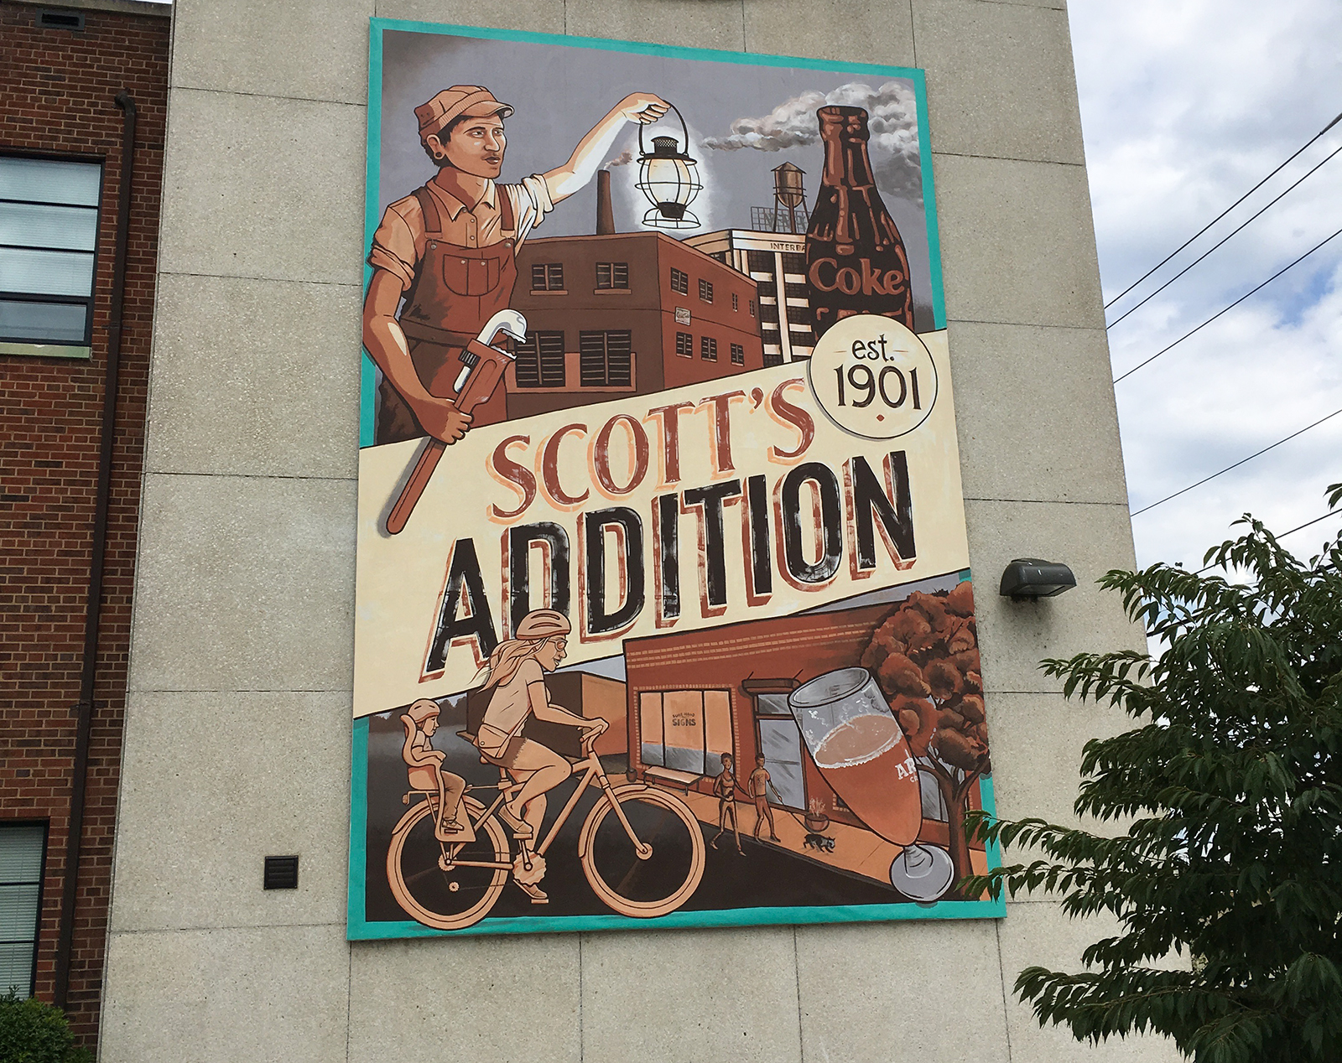
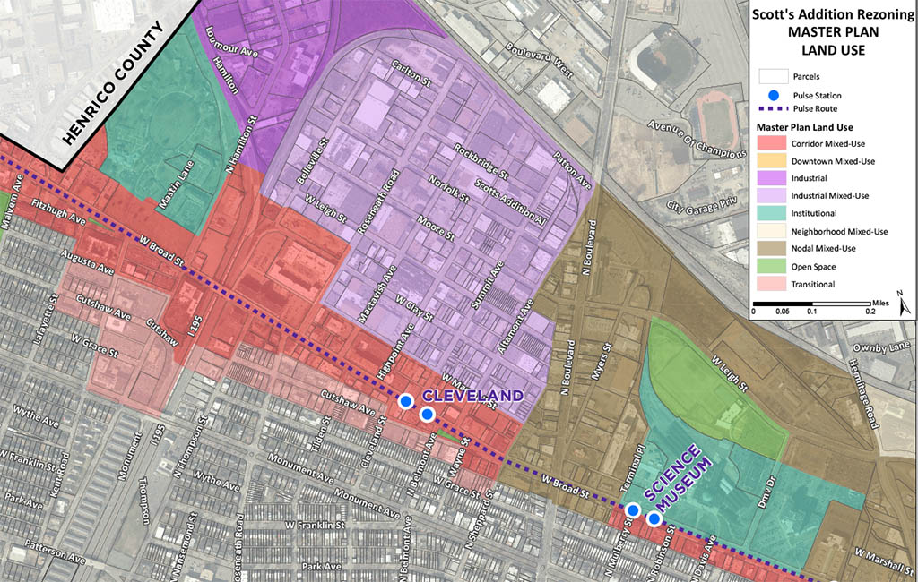
What is Scott’s Addition?
Notes:
Originally part of Mayo family plantation. I was named for General Scott who was a her of the War of 1812. At the turn of the 20th century businesses flocked to it as a transport hub. The 90’s saw a decline but as of the late 2000’s it has become a vibrant entertainment hub due to rezoning. The neighborhood was added to the National Register of Historic Places in 2005.

Slide 5
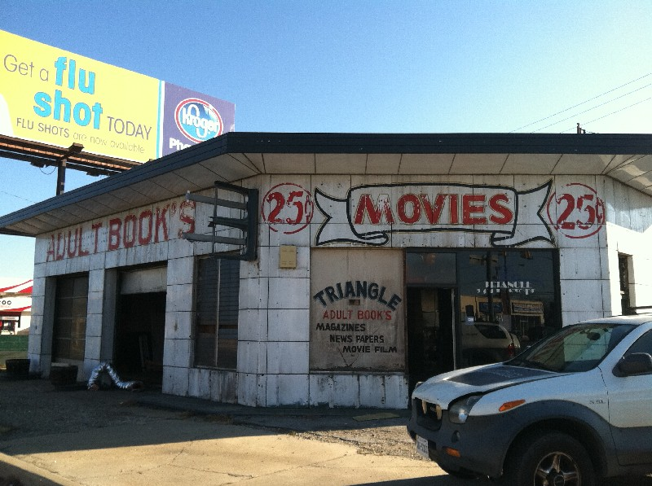
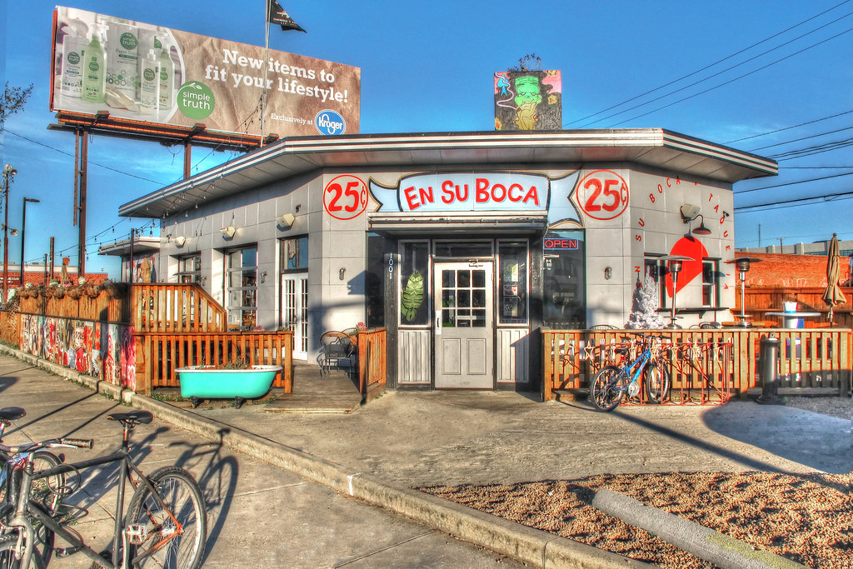

Slide 6
How to approach this problem?
Housing Data
Crime Data
Neighborhood Makeup

Slide 7
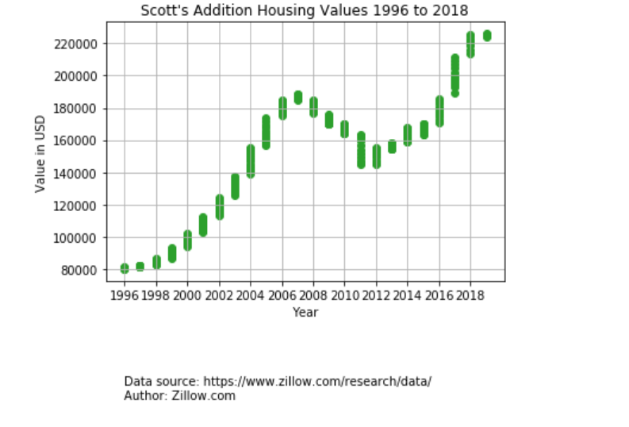
Housing Value Data Analysis
Notes:
Pulled housing value data from Zillow data dump. 1996 to 2018.

Slide 8
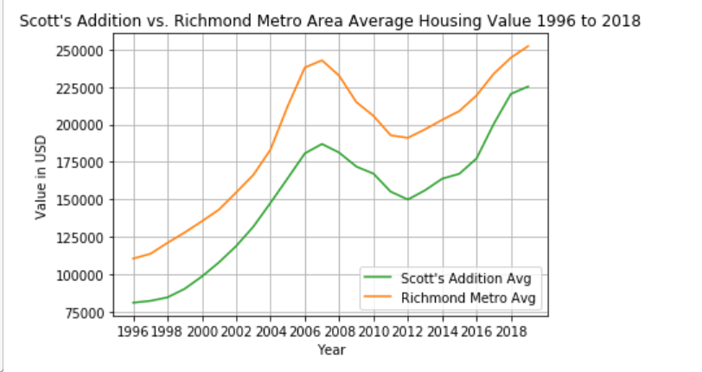
Housing Value Data Analysis

Slide 9
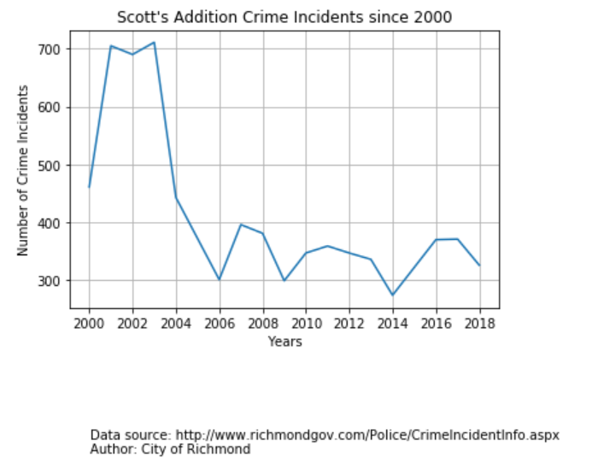
Crime Data
.

Slide 10
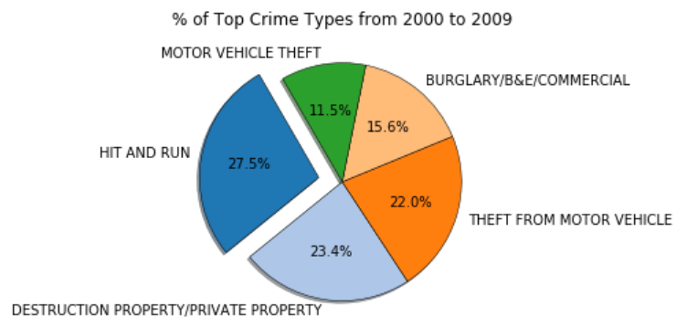
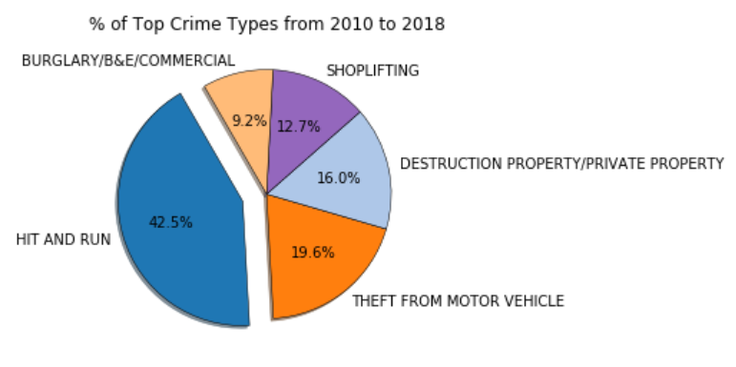

Slide 11
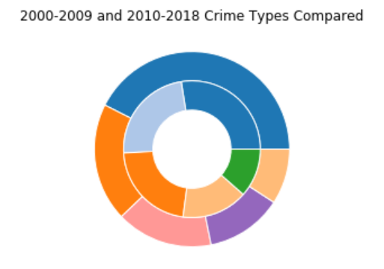

Slide 12
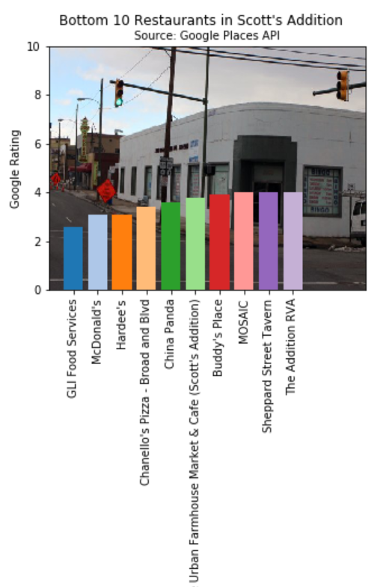
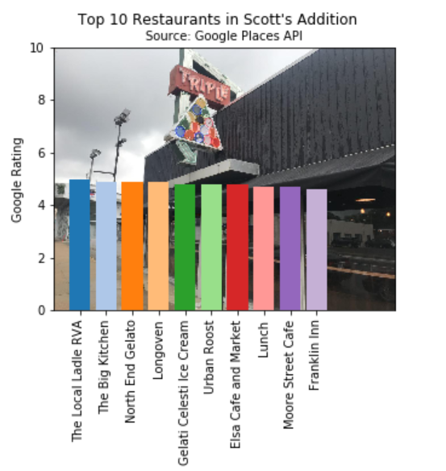
Neighborhood Makeup

Slide 13

A picture is worth a thousand words
A complex idea can be conveyed with just a single still image, namely making it possible to absorb large amounts of data quickly.

Slide 14




Limitations

Slide 15
